Slide 1

Instructions for staff applying to open competitions organised by EPSO
Guide for staff working for the EU Institutions, Bodies & Agencies

Slide 2
Is this guide for you?
Permanent officials
All EU staff
If you are a permanent official and do not plan any career change within the next 18 months, you can use your existing corporate EU Login.
You can close this guide and continue with your application.
This guide is for staff planning a career change within the next 18 months, including:
Permanent officials,
Blue Book trainees,
Contract Agents,
Temporary Agents,
etc.
If you belong to one of the above groups, please follow this guide.
Career change refers to:
an end of contract
moving to another EU institution
long-term absence (e.g., unpaid leave, CCP)
interruption of your current assignment

Slide 3
Table of contents
About this guide
Step 1: Check your account profile in the Single Candidate Portal
Step 2: Log in with your external EU Login account
Step 3: Set up multi-factor authentication
Step 4: Use your EU Login to create a Single Candidate Portal account

Slide 4
About this guide
To apply for an open competition, you need to have:
an EU Login account with multi-factor authentication,
a profile in the Single Candidate Portal.
Staff can use an external EU Login account connected to their personal email address (for example Gmail) or their work email (ending with .europa.eu). It is possible to have two types of accounts.
This guide will help you:
check what EU Login account type you currently use (corporate or external)
switch to, or create a new, external EU Login account
set up multi-factor authentication for a new EU Login account
access the Single Candidate Portal
Why is it important?
if you can't use your work email address in the next 18 months, you will not be able to access your application. You will also not get notifications about updates or test results from the EPSO competition you applied for.

Slide 5
Step 1: Check your account profile in the Single Candidate Portal

Slide 6
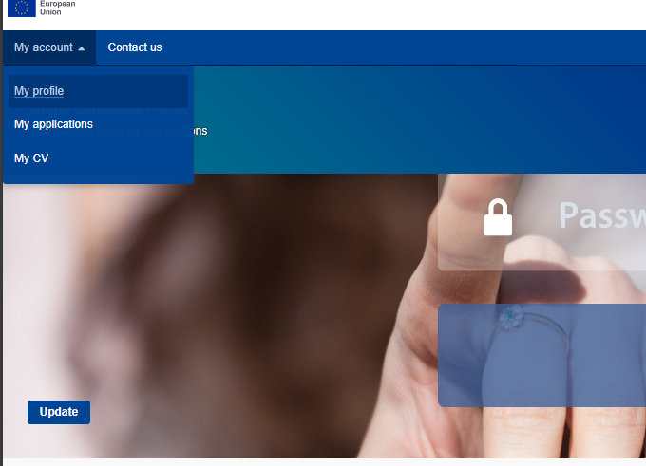
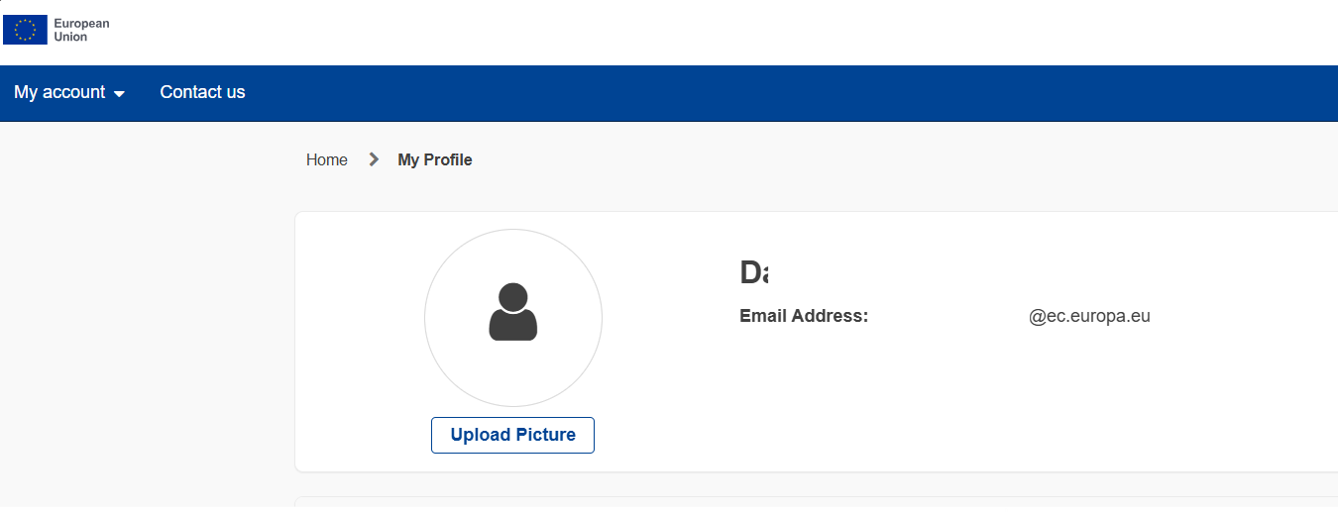
Log in to the Single Candidate Portal
4
Check your email address.
Select "My account“.
Click "My profile“.
4

Slide 7
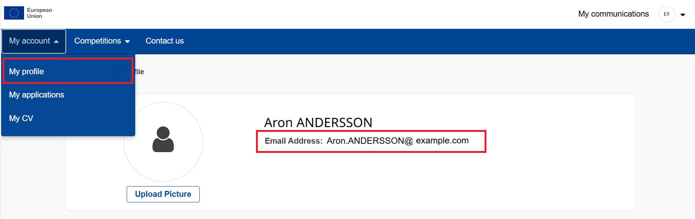
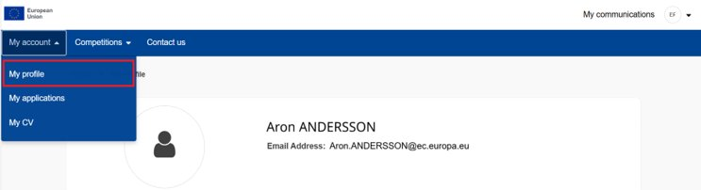

Scenario 1 - Your account is connected to an external EU Login
Scenario 2 - Your account is connected to a corporate EU Login
If your email address ends in .europa.eu, then your account is connected to a corporate EU Login account.
If your personal email address is displayed, the account is already connected to an external EU Login account.
You can also see label
at the top blue bar.
Corporate account
To apply for the competition, continue to the next slide.
Please use an external EU Login instead and continue follow this guide.

Slide 8
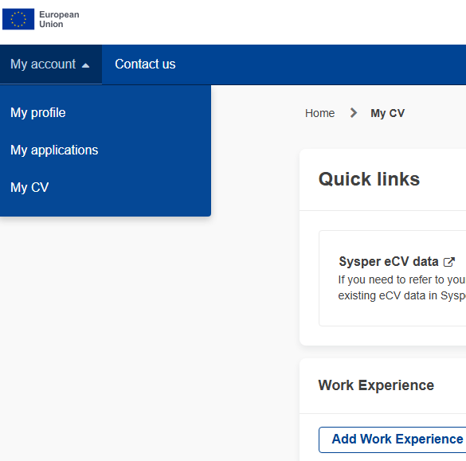
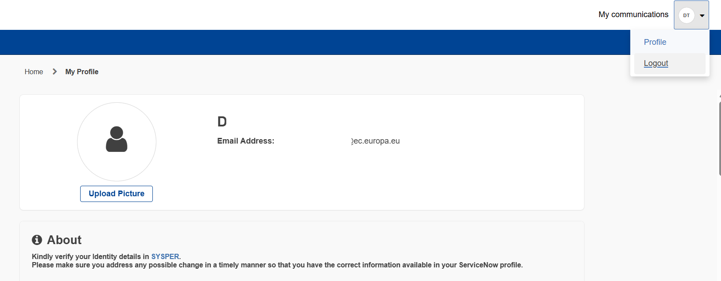
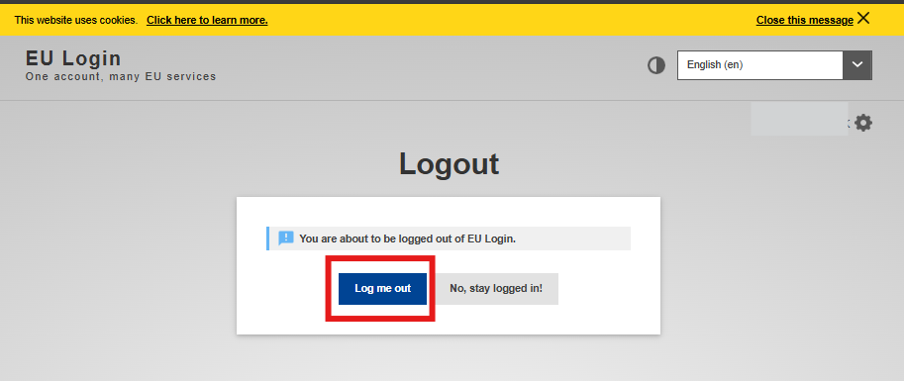
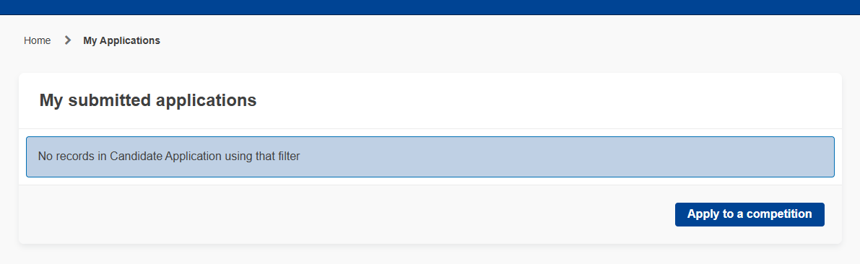
Scenario 1 - Your account is connected to an external EU Login
Scenario 2 - Your account is connected to a corporate EU Login
Click ”My account”.
In the Single Candidate Portal, click on the profile icon in the top right corner.
Click “My applications”.
Sign out by clicking "Logout“.
1
Confirm that you want to sign out by clicking “Log me out”.
Click “Apply to a competition” and apply for the competition.
You can close this guide and
apply for the competition.
✔

Slide 9
Step 2: Log in with your external EU Login account

Slide 10
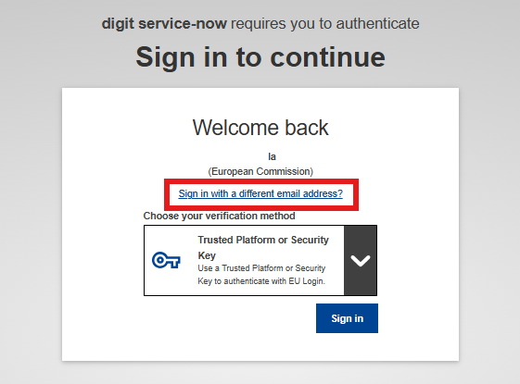
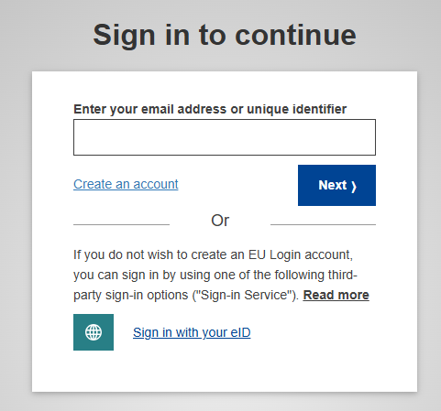
Log in to the EU Login page.
If you see the screen shown on the right,
select “Sign in with a different email address?”
Note: not all users will see this screen - if you don’t see this screen, just follow point 3.
Important: Please use the above link to proceed.
Using a different link may lead to a different result, so it is essential to use the one provided.
Enter your personal email address.
If this email address is not yet registered, you will be guided through creating a new account.
3
4
4
Click “Next”.

Slide 11


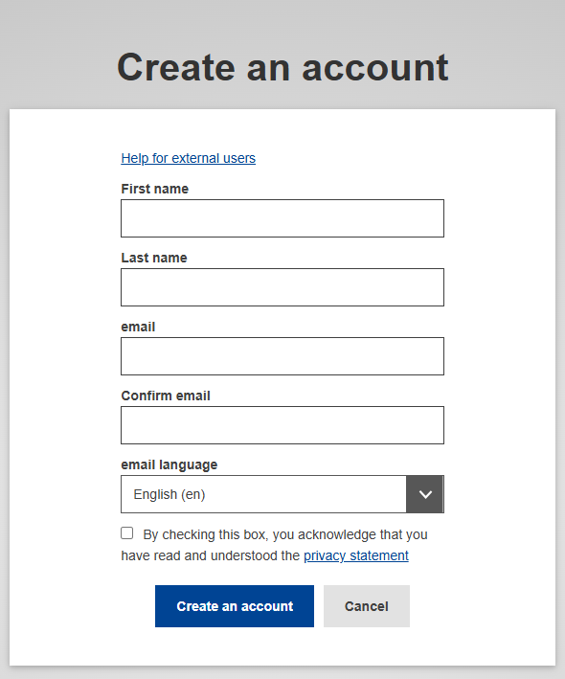
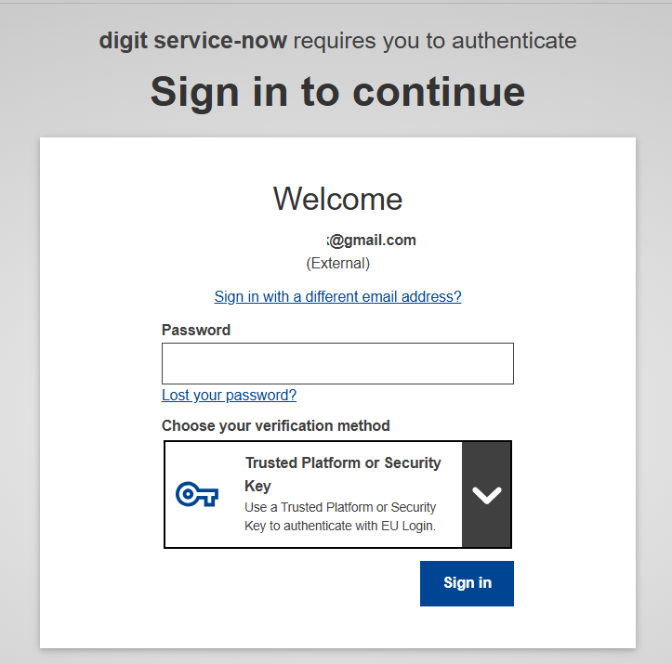

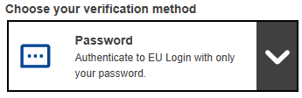
Scenario A - you already have external EU Login account
Scenario B - you don’t have an external EU Login account
Below your email address, you should see the text “(External)”.
Enter your password and choose verification method.
Click “Sign in”.
Enter your contact details:
  first name
  last name
  valid personal email address
  select your preferred language
Confirm that you have read and understood the privacy statement.
Click ”Create an account”.
Check your email, you should receive a verification email.
If other verification options are not working, choose “Password” to continue.
4

Slide 12
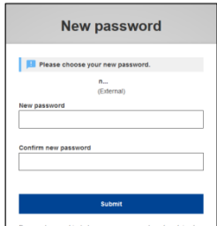
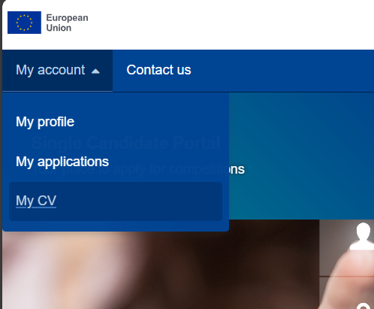
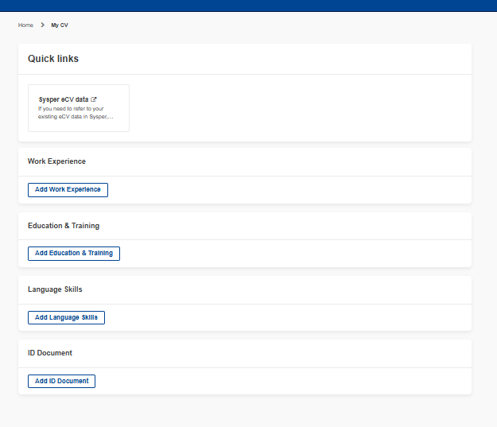
Scenario A - you already have external EU Login account
Scenario B - you don’t have an external EU Login account
Go to the Single Candidate Portal.
Open the email and click the link provided.
Choose a new password.
Click “My Account”.
Click “My CV”.
Passwords must contain at least 10 characters and include upper- and lowercase letters, numbers, and special characters.
4
Fill in the required information.
4
Confirm your password and click “Submit”.
Your new EU Login account is ready.
Follow the guide to set up multi-factor authentication.

Slide 13
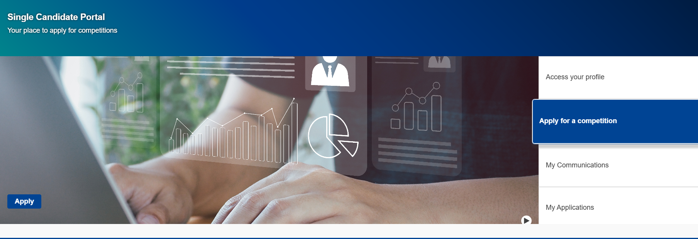
Scenario A - you already have external EU Login account
Scenario B - you don’t have an external EU Login account
5
Go to the main page
Your new EU Login account is ready.
Go to the next slide and continue follow this guide to set up multi-factor authentication.
6
Click “Apply for a competition”.
7
Click “Apply”.
You can then close this guide and continue with your application.
✔
6
7
If you cannot access the Single Candidate Portal, it means that multi-factor authentication is not configured for your account. To set it up, follow this guide.

Slide 14
Step 3: Set up multi-factor authentication
For users creating a new external EU Login account only.

Slide 15
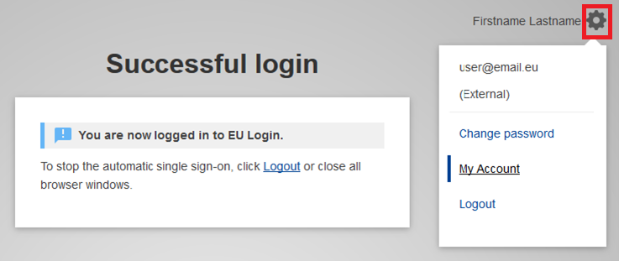
Before applying to a competition, you need to set up multi-factor authentication (MFA) for your EU Login account.
1
Log in to your external EU login account.
2
At the top right corner, click the settings icon.
3
Select “My account”.
2
3
Notes:
If you write this presentation in another language, make sure to

Slide 16
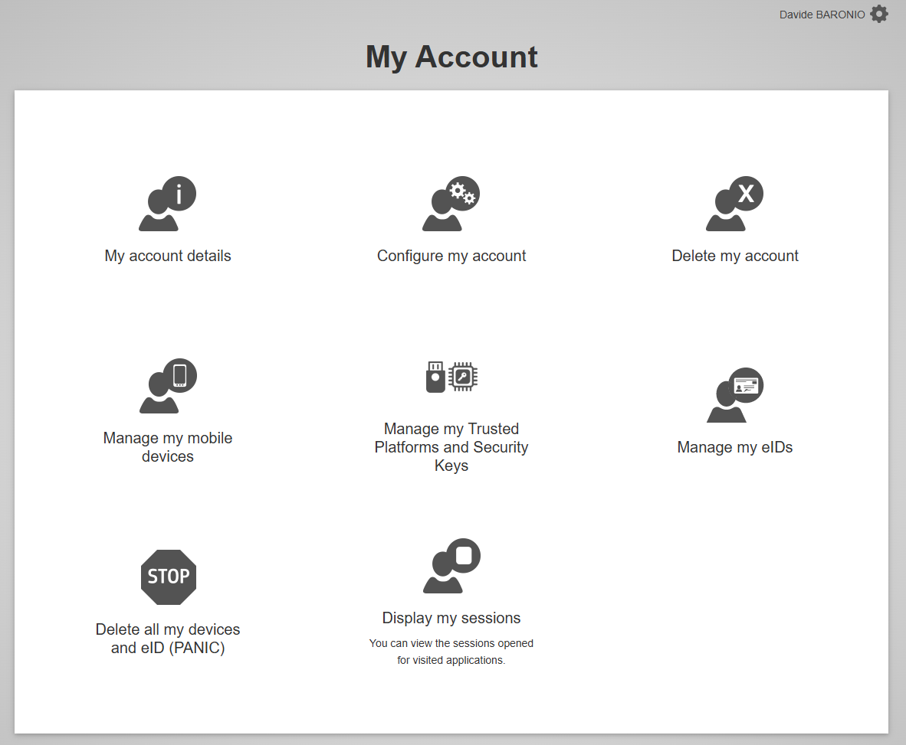
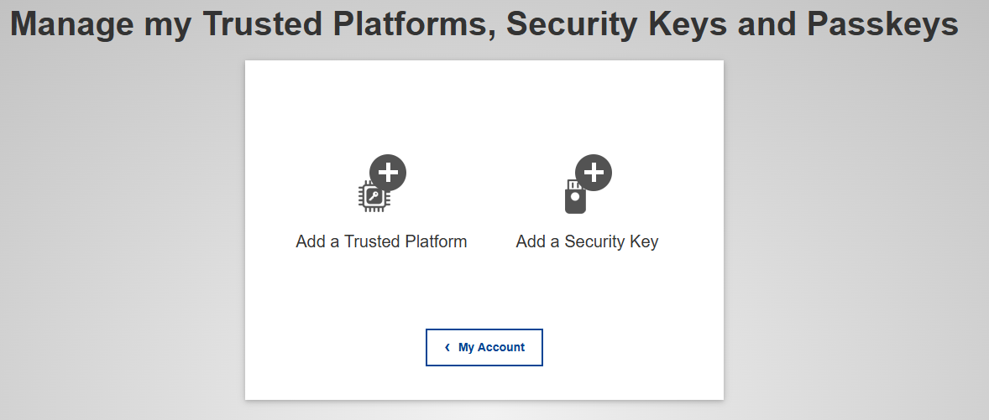
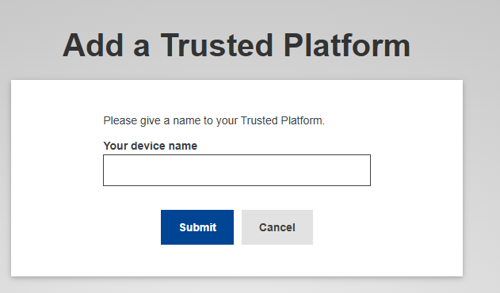
3
Select “Manage my Trusted Platforms and Security keys”.
4
Select “Add a Trusted platform".
5
Add a name for your Trusted Platform
(e.g.: "My computer").
6
Click ”Submit”.
4
5
3
6
A Trusted Platform is a device chosen by the user, such as a computer or a mobile phone.
Notes:
If you write this presentation in another language, make sure to

Slide 17
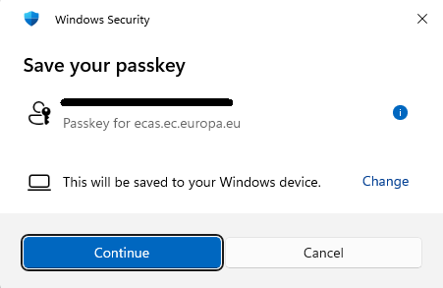
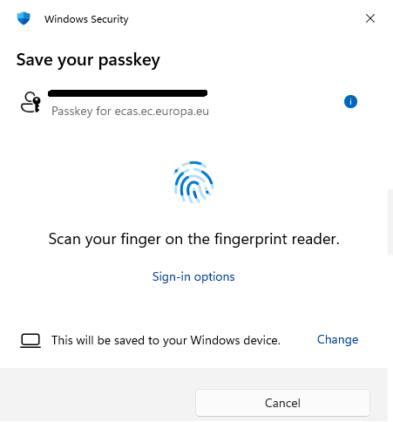
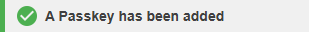
Click “Continue”.
You will be requested to perform a validation.
The default sign-in option varies by device. To change it, click “Sign-in options”
Done! You will see a confirmation message.
7
8
9
8
We recommend using a personal desktop device as your Trusted Platform.
If you would like to use a mobile device instead, please refer to the separate guide.

Slide 18
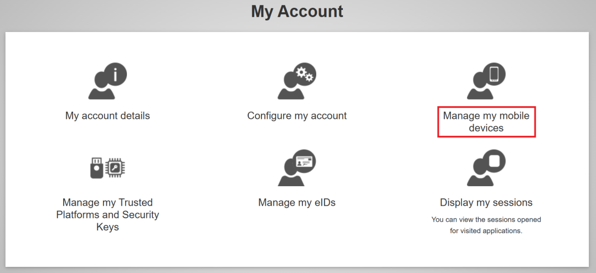
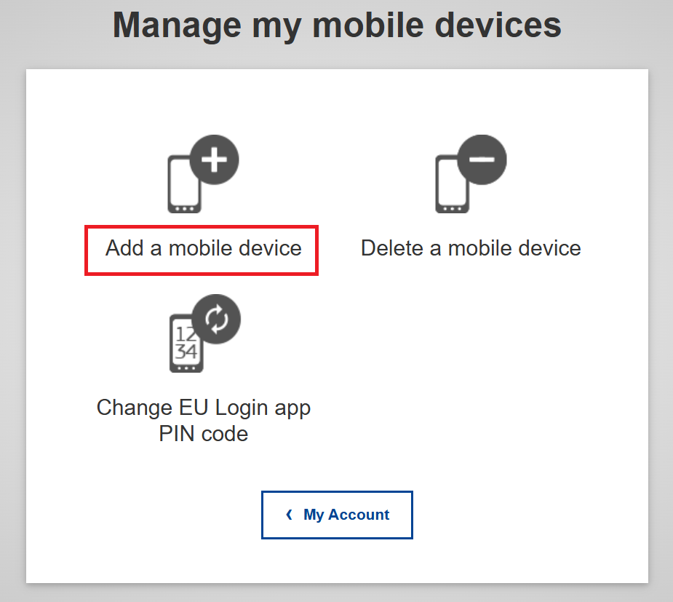
You can add multiple accounts to the EU Login app by following this guide.
However, make sure that you have a mobile device with the EU Login app installed. If not, follow this guide to register your device.
After successfully adding your internal and external accounts, it is possible to:
Authenticate using any of the accounts registered in your EU Login app.
Switch between accounts

Slide 19
Step 4: Use your EU Login to create a Single Candidate Portal account.
For users creating a new external EU Login account only.

Slide 20
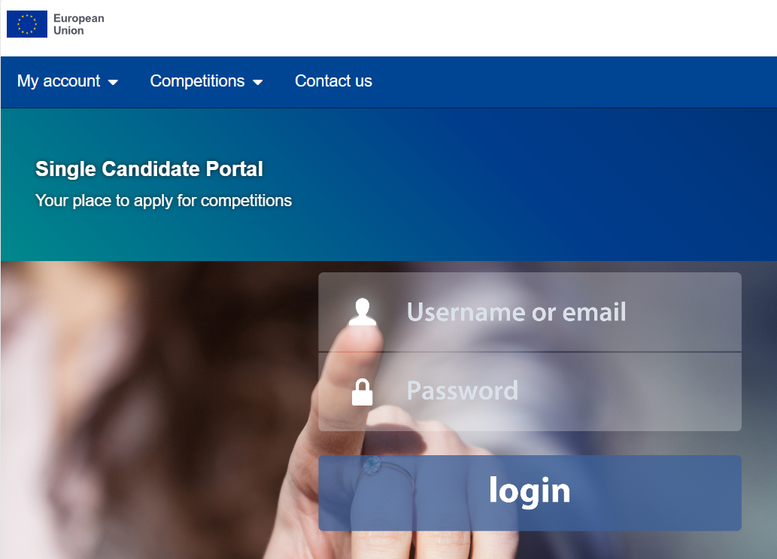
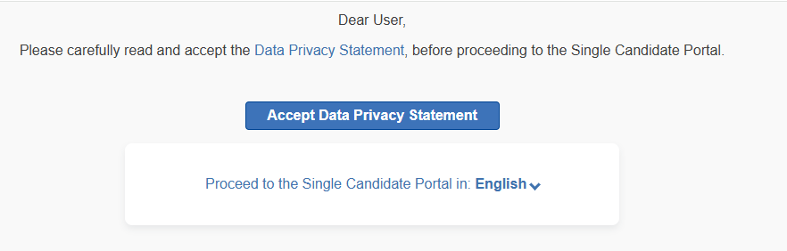
To apply to an open competition, you need an account in the Single Candidate Portal
linked to your external EU Login and personal email address.
1
Go to the Single Candidate Portal.
2
Read through the privacy statement and click
“Accept Data Privacy Statement”.
2

Slide 21
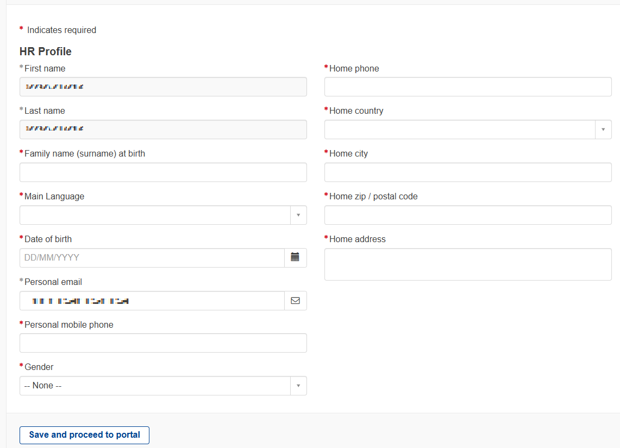
3
Enter your personal details.
Some fields will already be pre-filled.
3
4
Click "Save and proceed to portal".
4

Slide 22
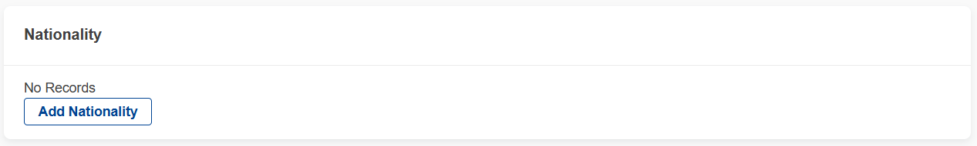
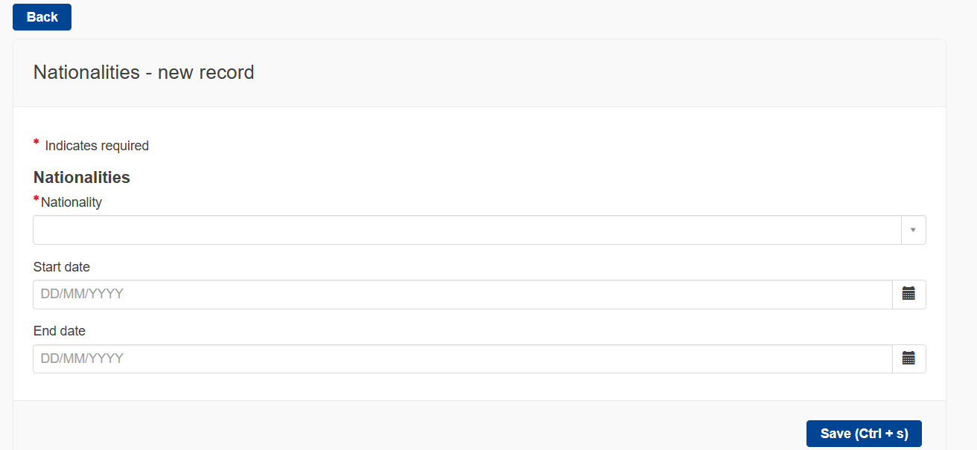
5
At the bottom of the screen, you will find a section called “Nationality”.
6
Click “Add Nationality”. A new page will open.
6
9
7
Enter your nationality.
If you have more than one citizenship, please enter all nationalities.
7
8
Click “Save”.
9
Click "Back”.
8

Slide 23
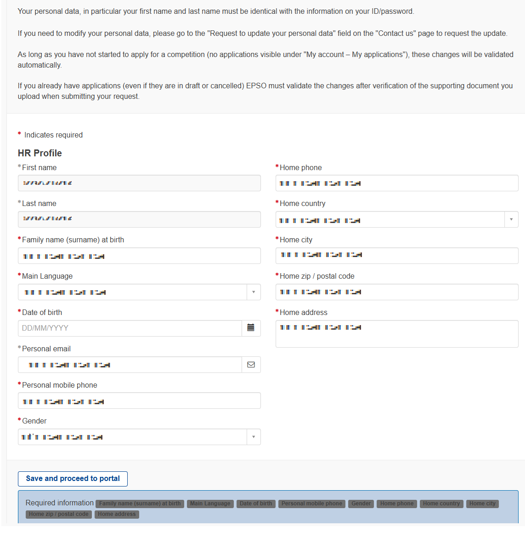
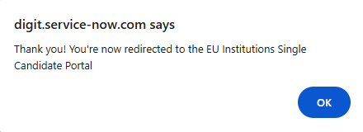
10
Review your data and confirm by clicking
“Save and proceed to portal”.
11
A pop up will appear and you should be automatically redirected to the Single Candidate Portal.
10

Slide 24
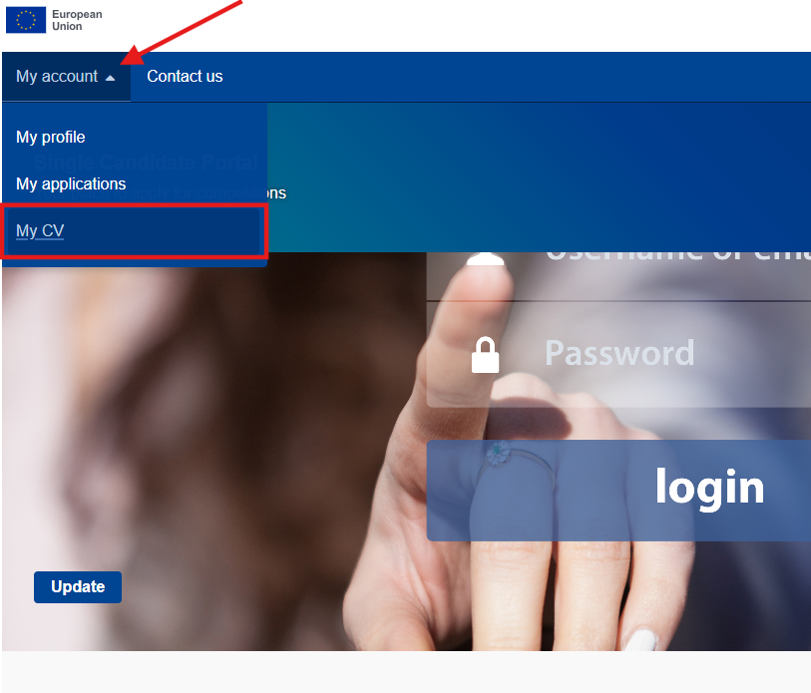
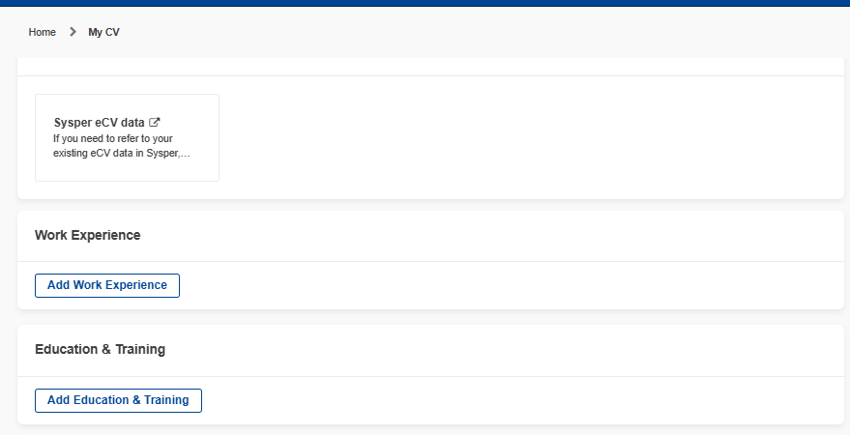
12
Go to the Single Candidate Portal.
Click ”My account”.
14
Click “My CV”.
Fill in the required information.
13
15
13
15
14

Slide 25
Click “Apply to a competition” and apply for the competition.
Click ”My account”.
Click “My applications”.
16
18
17
16
17
18
✔
You are now ready to apply for the competition.

Slide 26
Do you have more questions?
You may check the links below for the most frequently asked questions.
Creating, managing and using your EU Login account - EU Login Portal
How to change/reset my EU Login password? - EU Login Portal
How can I add a Security Key or a Trusted Platform? - EU Login Portal
How to fill in the application form | EU Careers

